Slide 1
21CSC201J DATA STRUCTURES AND ALGORITHMS UNIT-4 Topic : Trees

Slide 2
TREES

Slide 3
Introduction to Trees
The study of trees in mathematics can be traced to Gustav Kirchhoff in the middle nineteenth century and several years later to Arthur Cayley, who used trees to study the structure of algebraic formulas.
Cayley’s work undoubtedly laid the framework for Grace Hopper’s use of trees in 1951 to represent arithmetic expressions.
Hopper’s work bears a strong resemblance to today’s binary tree formats.
Trees are used extensively in computer science to represent algebraic formulas;
as an efficient method for searching large, dynamic lists; and for such diverse applications as artificial intelligence systems and encoding algorithms.

Slide 4
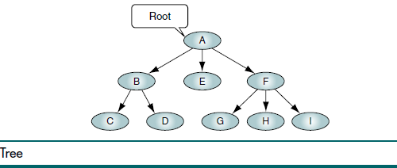
Basic Tree Concepts
A tree consists of a finite set of elements, called nodes, and a finite set of directed lines, called branches, that connect the nodes.
The number of branches associated with a node is the degree of the node.
When the branch is directed toward the node, it is an indegree branch; when the branch is directed away from the node, it is an outdegree branch.
The sum of the indegree and outdegree branches is the degree of the node.
A tree consists of a finite set of elements, called nodes, and a finite set of directed lines, called branches, that connect the nodes.

Slide 5
TREE

Slide 6
TREE Terminology
If the tree is not empty, the first node is called the root.
The indegree of the root is, by definition, zero.
With the exception of the root, all of the nodes in a tree must have an indegree of exactly one; that is, they may have only one predecessor.
All nodes in the tree can have zero, one, or more branches leaving them; that is, they may have an outdegree of zero, one, or more (zero or more successors). Figure 6-1 is a representation of a tree.

Slide 7
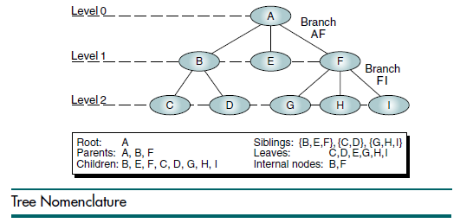
TREE Terminology
A leaf is any node with an outdegree of zero, that is, a node with no successors.
A node that is not a root or a leaf is known as an internal node because it is found in the middle portion of a tree.
A node is a parent if it has successor nodes—that is, if it has an outdegree greater than zero.
Conversely, a node with a predecessor is a child.
A child node has an indegree of one.
Two or more nodes with the same parent are siblings
An ancestor is any node in the path from the root to the node.
A descendent is any node in the path below the parent node; that is, all nodes in the paths from a given node to a leaf are descendents of that node

Slide 8
PATH
Several terms drawn from mathematics or created by computer scientists are used to describe attributes of trees and their nodes
A path is a sequence of nodes in which each node is adjacent to the next one.
Every node in the tree can be reached by following a unique path starting from the root.
In Figure 6-2 the path from the root to the leaf I is designated as AFI.
It includes two distinct branches, AF and FI.

Slide 9
LEVEL
The level of a node is its distance from the root. Because the root has a zero distance from itself, the root is at level 0.
The children of the root are at level 1, their children are at level 2, and so forth.
Note the relationship between levels and siblings in Figure 6-2.
Siblings are always at the same level, but all nodes in a level are not necessarily siblings.
For example, at level 2, C and D are siblings, as are G, H, and I.
However, D and G are not siblings because they have different parents

Slide 10
HEIGHT
The height of the tree is the level of the leaf in the longest path from the root plus 1.
By definition the height of an empty tree is -1.
Figure 6-2 contains nodes at three levels: 0, 1, and 2. Its height is 3.
Because the tree is drawn upside down, some texts refer to the depth of a tree rather than its height.
The level of a node is its distance from the root. The height of a tree is the level of the leaf in the longest path from the root plus 1.

Slide 11
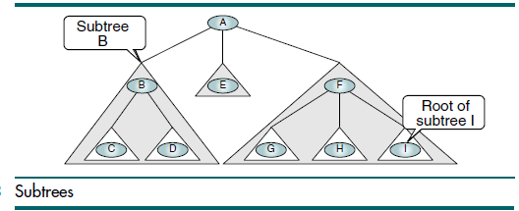
SUBTREES
A tree may be divided into subtrees.
A subtree is any connected structure below the root.
The first node in a subtree is known as the root of the subtree and is used to name the subtree.
Subtrees can also be further subdivided into subtrees.
In Figure 6-3, BCD is a subtree, as are E and FGHI. Note that by this definition, a single node is a subtree.
Thus, the subtree B can be divided into two subtrees, C and D, and the subtree F contains the subtrees G, H, and I.

Slide 12
TREE DEFN
A tree is a set of nodes that either:
1. Is empty, or
2. Has a designated node, called the root, from whi
The concept of subtrees leads us to a recursive definition of a tree: A tree
is a set of nodes that either: (1) is empty or (2) has a designated node, called the root, from which hierarchically descend zero or more subtrees, which are also trees.

Slide 13
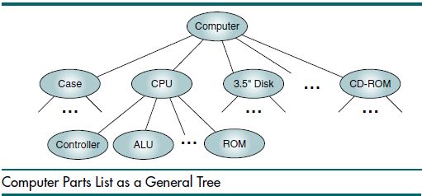
User Representation
There are three different user representations for trees. The first is the organization chart format, which is basically the notation we use to represent
trees in our figures. The term we use for this notation is general tree. The general
tree representation of a computer’s components is shown in Figure

Slide 14
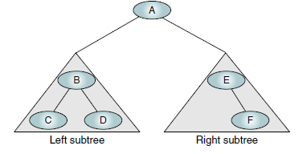
Binary Trees
A binary tree is a tree in which no node can have more than two subtrees;
the maximum outdegree for a node is two.
In other words, a node can have zero, one, or two subtrees.
These subtrees are designated as the left subtree and the right subtree.
Figure 6-5 shows a binary tree with its two subtrees. Note that each subtree is itself a binary tree.

Slide 15
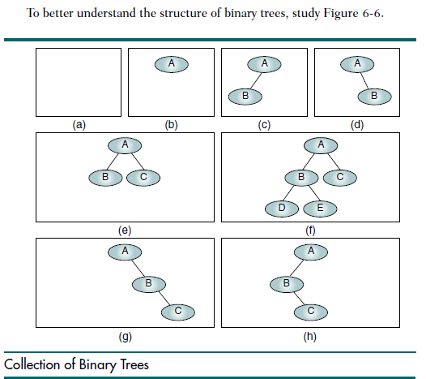

Slide 16

Binary Tree Properties
Height of Binary Trees
Maximum Height
Given that we need to store N nodes in a binary tree, the maximum height,
Hmax, is

Slide 17
Example
Given three nodes to be stored in a binary tree, what is the maximum height?
In this example N is 3. Therefore, the maximum height is 3. There are four different trees that can be drawn to satisfy a maximum height of 3. A tree with a maximum height is rare.

Slide 18
Minimum Height
The minimum height of the tree, Hmin, is determined by the following formula:
Hmin = log2N + 1
Example Given three nodes to be stored in a binary tree, what is the minimum height?
Again, N is 3. Therefore, the minimum height is 2.
Minimum Nodes.
We can turn the calculation around and determine the minimum number of nodes in a tree of a specified height. Given a height of the binary tree, H, the minimum number of nodes in the tree are given as
Nmin = H

Slide 19
Example
Given a tree of height 3, what is the minimum number of nodes that can be
stored? Using the formula for Nmin, the answer is H, or 3 nodes. This case is
seen in Figure 6-6(g) and 6-6(h).

Slide 20

Maximum Nodes
The formula for the maximum number of nodes is derived from the fact that each node can have only two descendents. Given a height of the binary tree, H, the maximum number of nodes in the tree is given as
Given a tree of height 3, what is the maximum number of nodes that can be stored? Nmax is 7.

Slide 21

Balance
To determine whether a tree is balanced, we calculate its balance
factor. The balance factor of a binary tree is the difference in height between its
left and right subtrees. If we define the height of the left subtree as HL and the
height of the right subtree as HR, the balance factor of the tree, B, is determined
by the following formula:

Slide 22
Using this formula, the balances of the eight trees in Figure 6-6 are (a) 0
by definition, (b) 0, (c) 1, (d) –1, (e) 0, (f) 1, (g) –2, and (h) 2.

Slide 23
Complete and Nearly Complete Binary Trees
A complete tree has the maximum number of entries for its height (see formula
Nmax in “Height of Binary Trees”). The maximum number is reached when the
last level is full (see Figure 6-7). A tree is considered nearly complete if it has the
minimum height for its nodes (see formula Hmin) and all nodes in the last
level are found on the left. Complete and nearly complete trees are shown in
Figure 6-7.

Slide 24
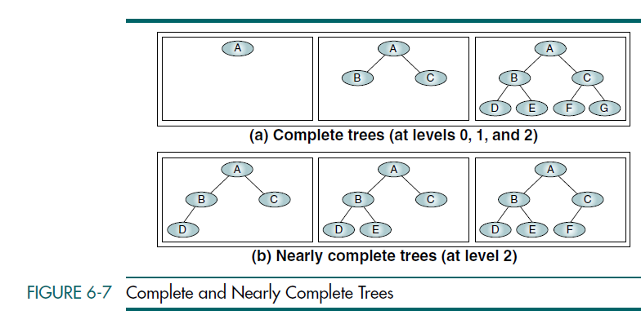

Slide 25
Binary Tree Traversals
A binary tree traversal requires that each node of the tree be processed once and only once in a predetermined sequence.
The two general approaches to the traversal sequence are depth first and breadth first.
In a breadth-first traversal, the processing proceeds horizontally from the root to all of its children, then to its children’s children, and so forth until all nodes have been processed. In other words, in the breadth-first traversal, each level is completely processed before the next level is started.

Slide 26
Depth-first Traversals
Given that a binary tree consists of a root, a left subtree, and a right subtree,we can define six different depth-first traversal sequences.

Slide 27
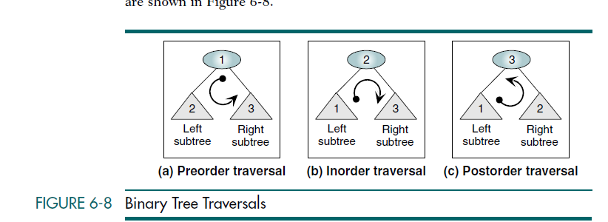

Slide 28
Binary Search Trees-Basic Concepts
A binary search tree (BST) is a binary tree with the following properties:
• All items in the left subtree are less than the root.
• All items in the right subtree are greater than or equal to the root.
• Each subtree is itself a binary search tree.

Slide 29
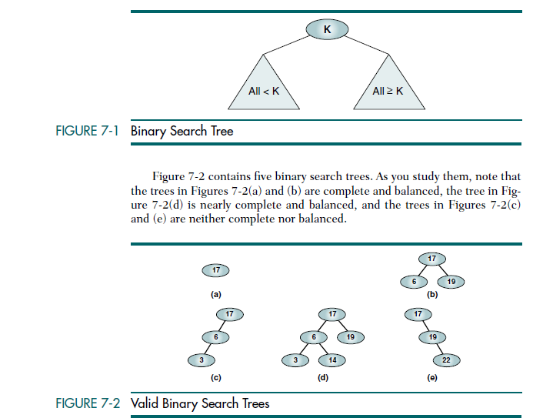

Slide 30
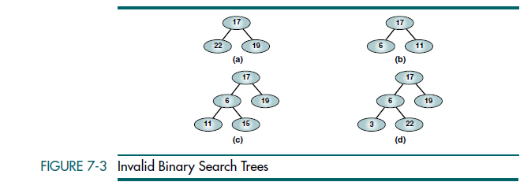

Slide 31
Searches-Find the Smallest Node
Algorithm findSmallestBST (root)
This algorithm finds the smallest node in a BST.
Pre root is a pointer to a nonempty BST or subtree
Return address of smallest node
1 if (left subtree empty)
1 return (root)
2 end if
3 return findSmallestBST (left subtree)
end findSmallestBST

Slide 32
Find the Largest Node
This time we start at the tree root and follow the right branches to the far-right node in the tree, which by definition must be the largest. The pseudocode is shown in Algorithm 7-2.
Algorithm findLargestBST (root)
This algorithm finds the largest node in a BST.
Pre root is a pointer to a nonempty BST or subtree
Return address of largest node returned
1 if (right subtree empty)
1 return (root)
2 end if
3 return findLargestBST (right subtree)
end findLargestBST

Slide 33
Search BST
Algorithm searchBST (root, targetKey)
Search a binary search tree for a given value.
Pre root is the root to a binary tree or subtree
targetKey is the key value requested
Return the node address if the value is found
null if the node is not in the tree
1 if (empty tree)
Not found
1 return null
2 end if
3 if (targetKey < root)
1 return searchBST (left subtree, targetKey)
4 else if (targetKey > root)
1 return searchBST (right subtree, targetKey)
5 else
Found target key
1 return root
6 end if
end searchBST

Slide 34
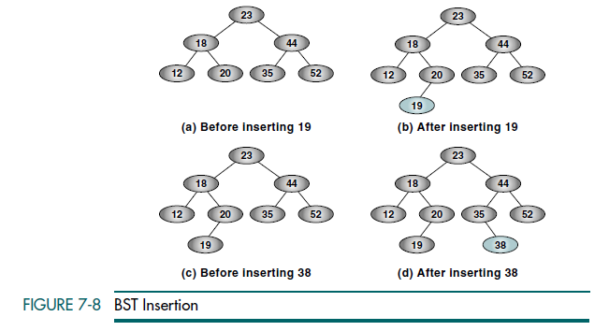
Insertion

Slide 35
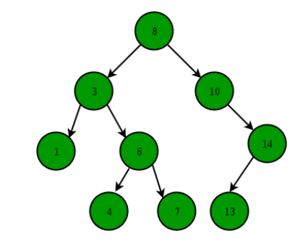
Binary Search Tree ADT

